Slide 1

What Are You Doing Planner

Slide 2
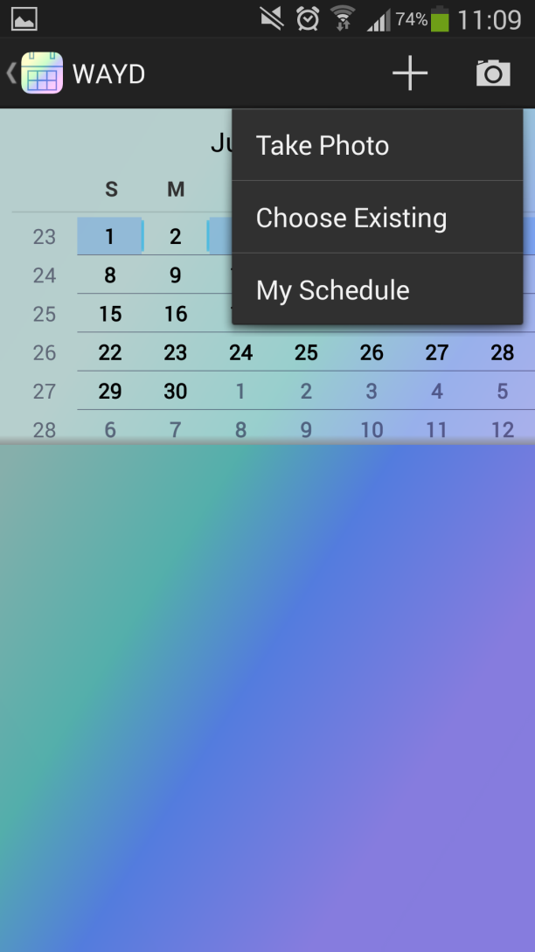
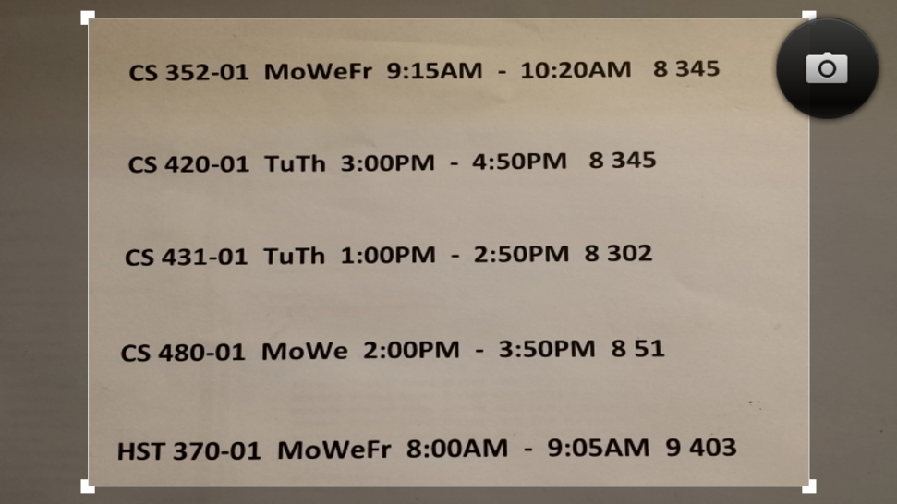
OCR

Slide 3


Slide 4
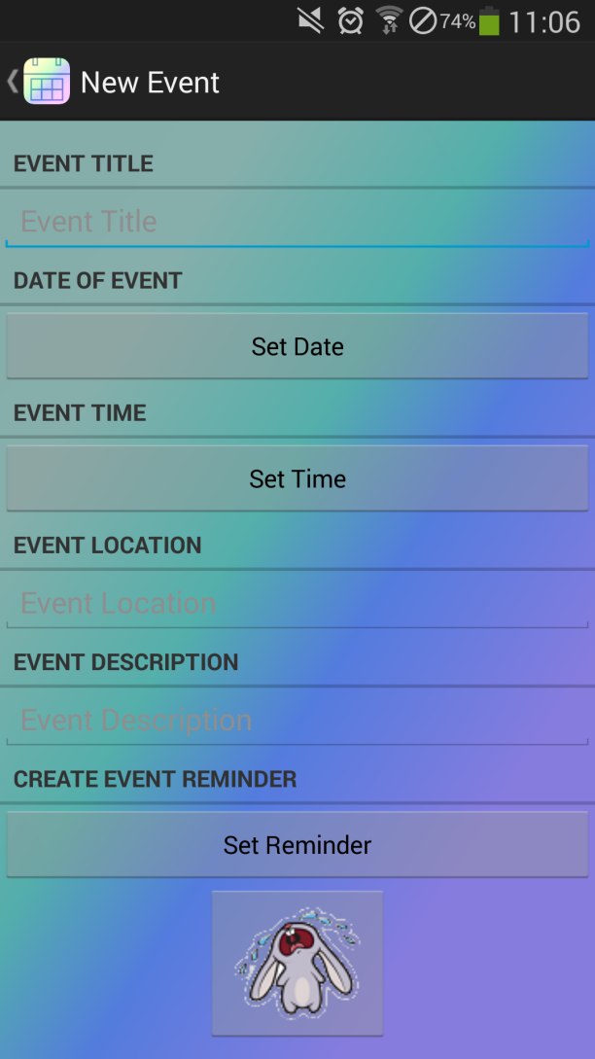
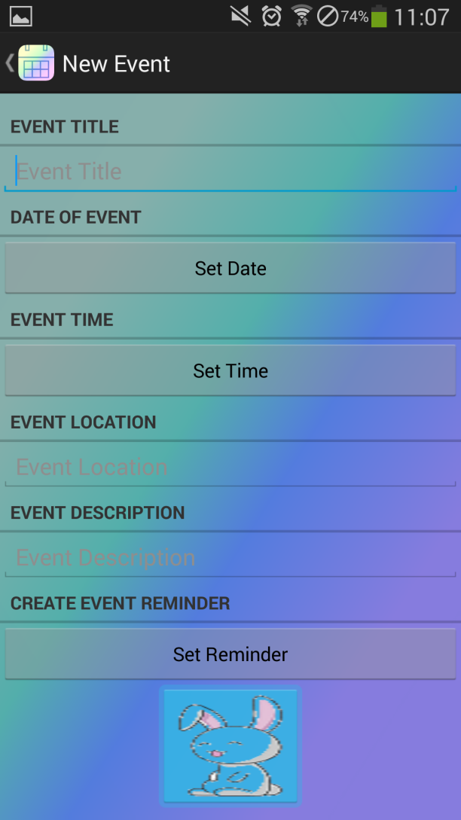
Create Your Event

Slide 5
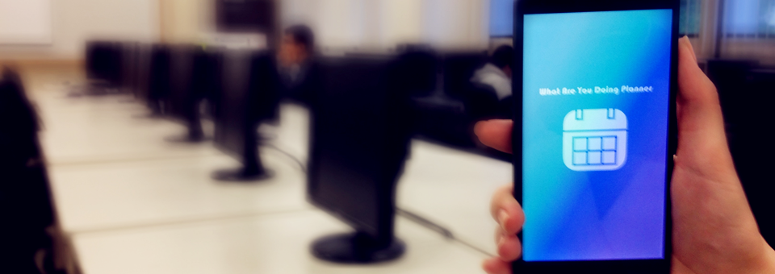

Slide 6
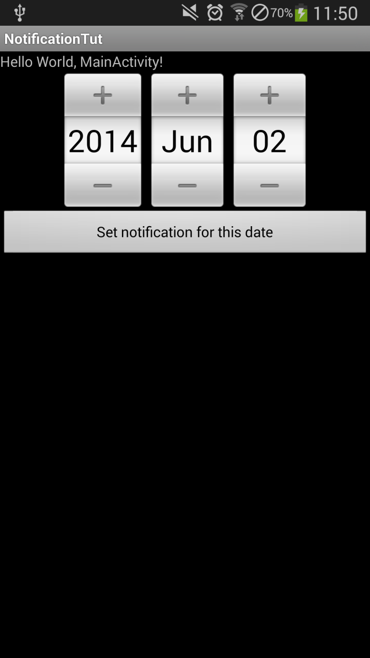
Notification
User has option to create a reminder of event

Slide 7



Slide 8
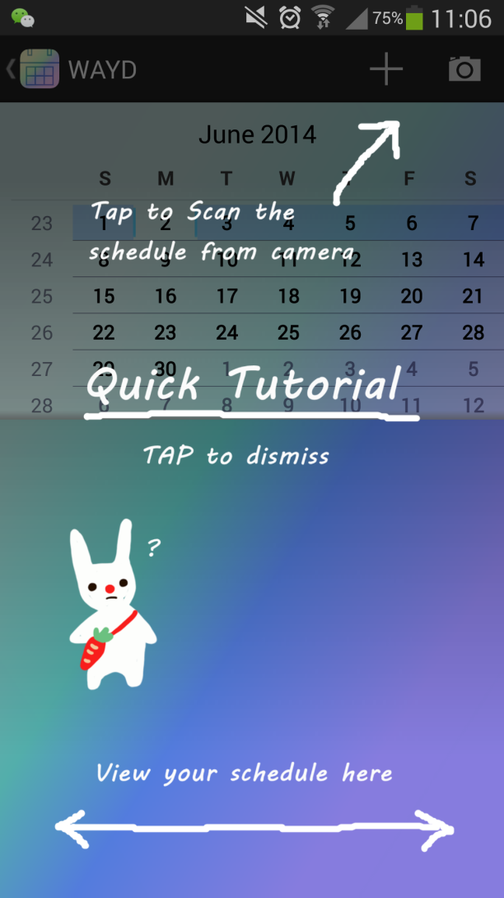
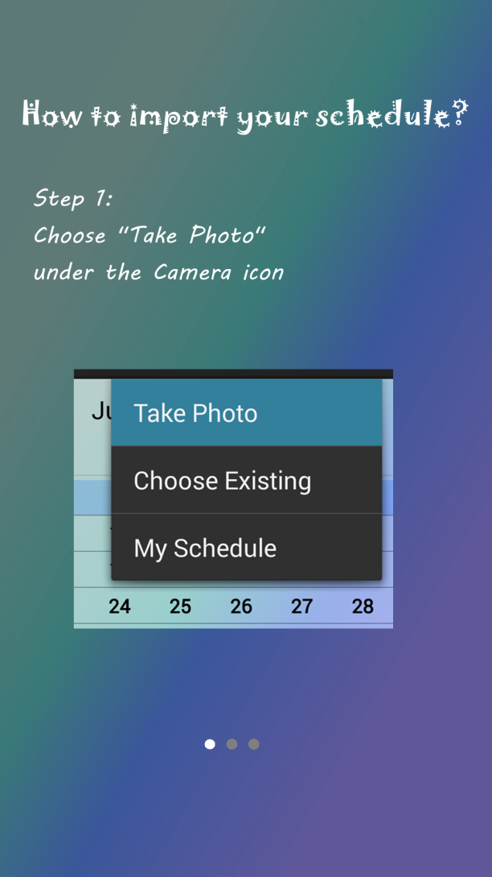
Help Your self, easy to start

Slide 9
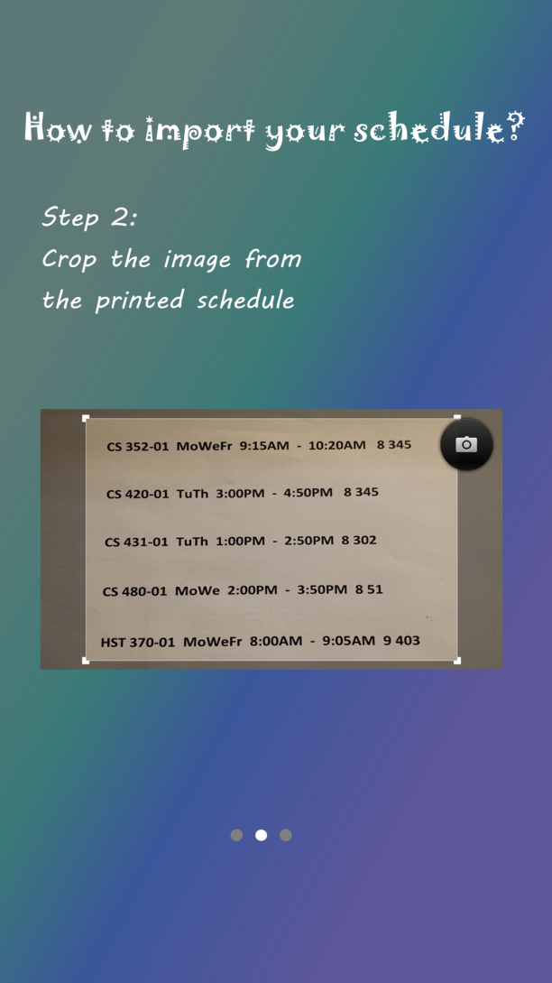
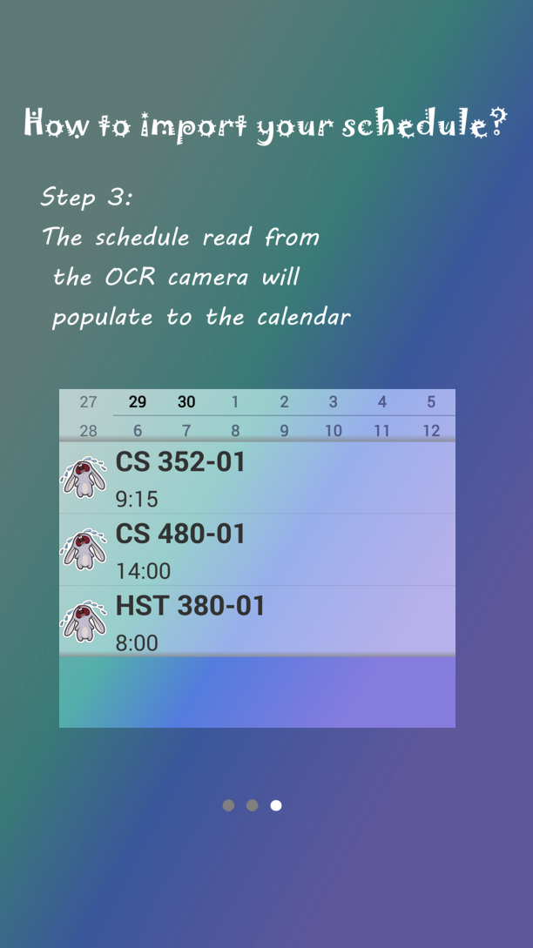
Help Your self, easy to start

Slide 10
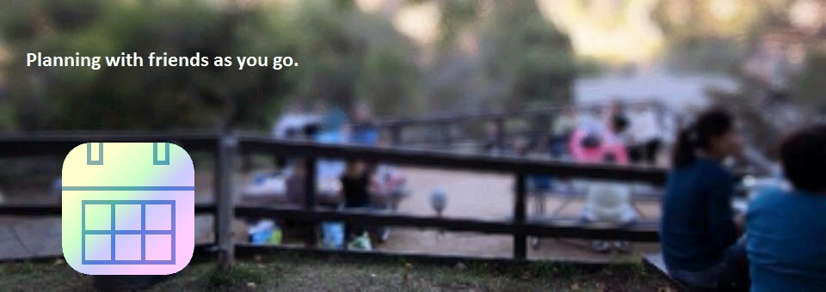
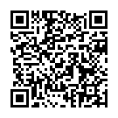
Facebook: https://www.facebook.com/WhatAreYouDoingPlanner Twitter: https://twitter.com/WAYDPlanner
CryingRabbit - What Are You Doing Planner
Website: http://www.csupomona.edu/~waynehuang/WhatAreYouDoingPlanner/

